Slide 1

Product Design
As a group we decided to create an interactive website which will be advertising a book. The website will act as a short prequel story to the book. It will require the user navigate the website and look for clues and evidence. The user will complete microgames/puzzles to obtain leads, eventually leading them to the diary of the killer.
The interactive elements are presented logically, incorporating website standards such as a navigational bar which the user will already know how to use.

Slide 2
Roles:
Daniel: Engineer
Dominik: Artist
Carly: Designer
Jhulissa: Designer

Slide 3
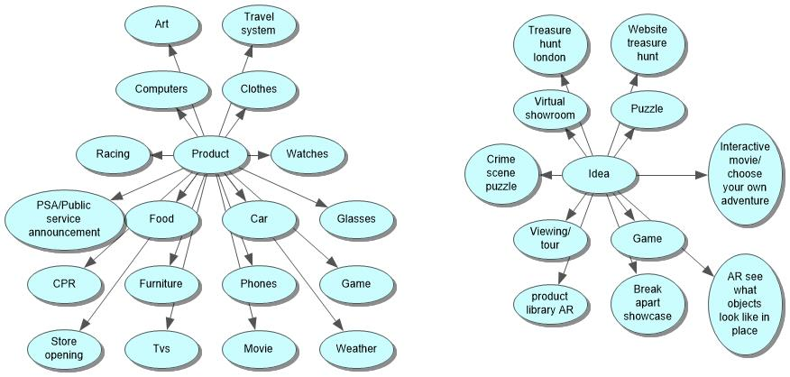
Ideation

Slide 4
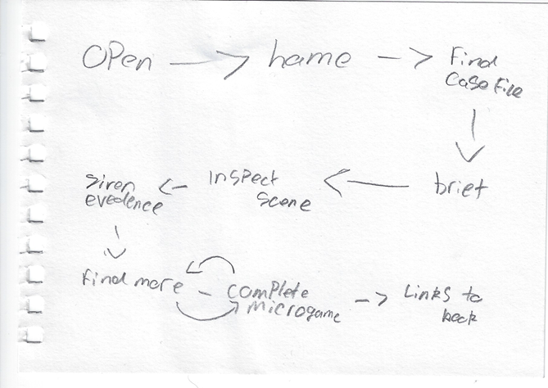
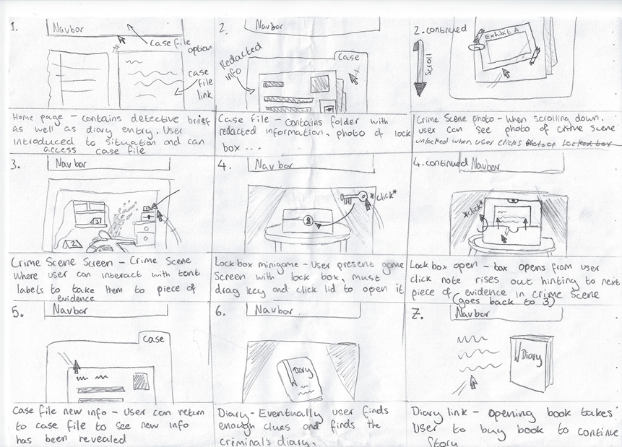
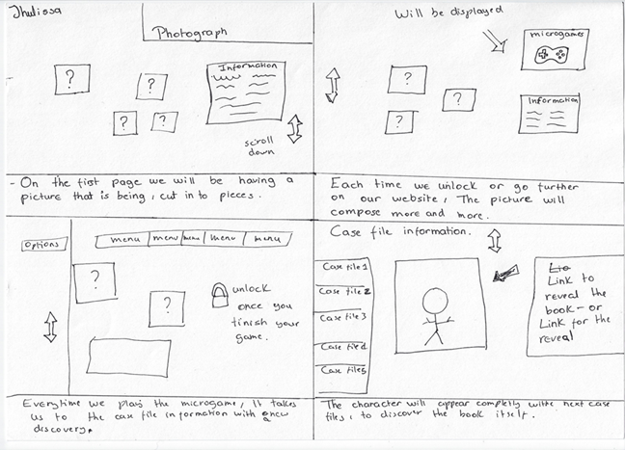
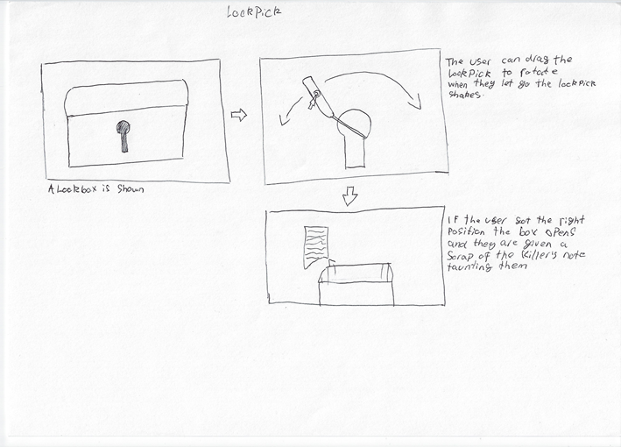
Flow chart
Microgames
User progression though the website
Photograph reconstruction
Lockpick

Slide 5
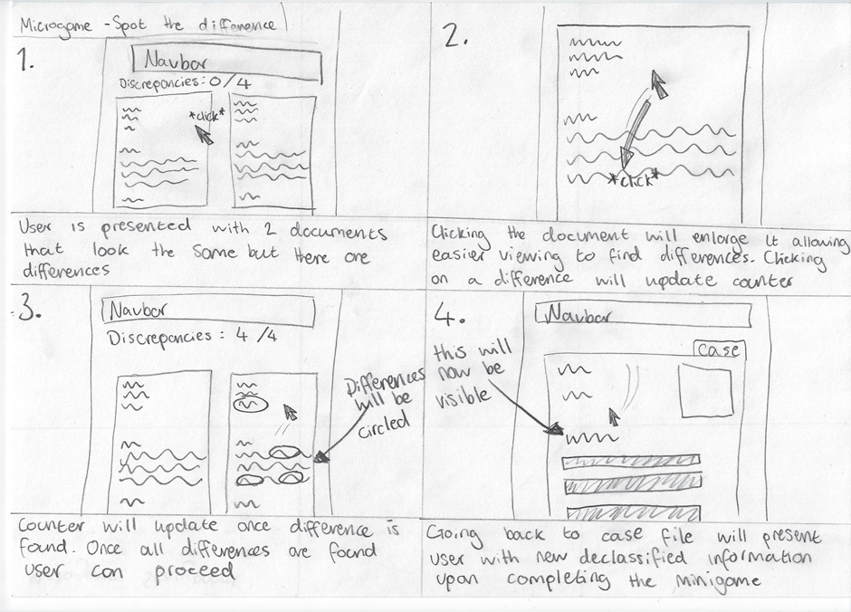
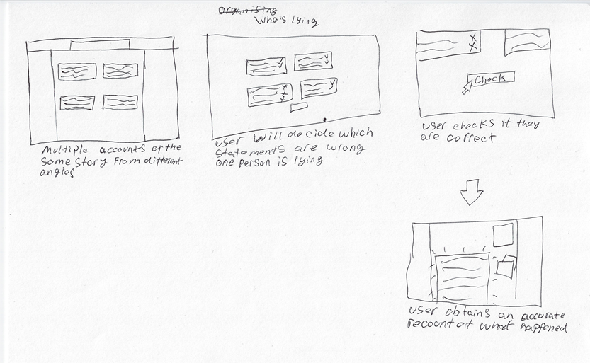
Microgames
Comparing Documents
Spot Statement Discrepancies

Slide 6
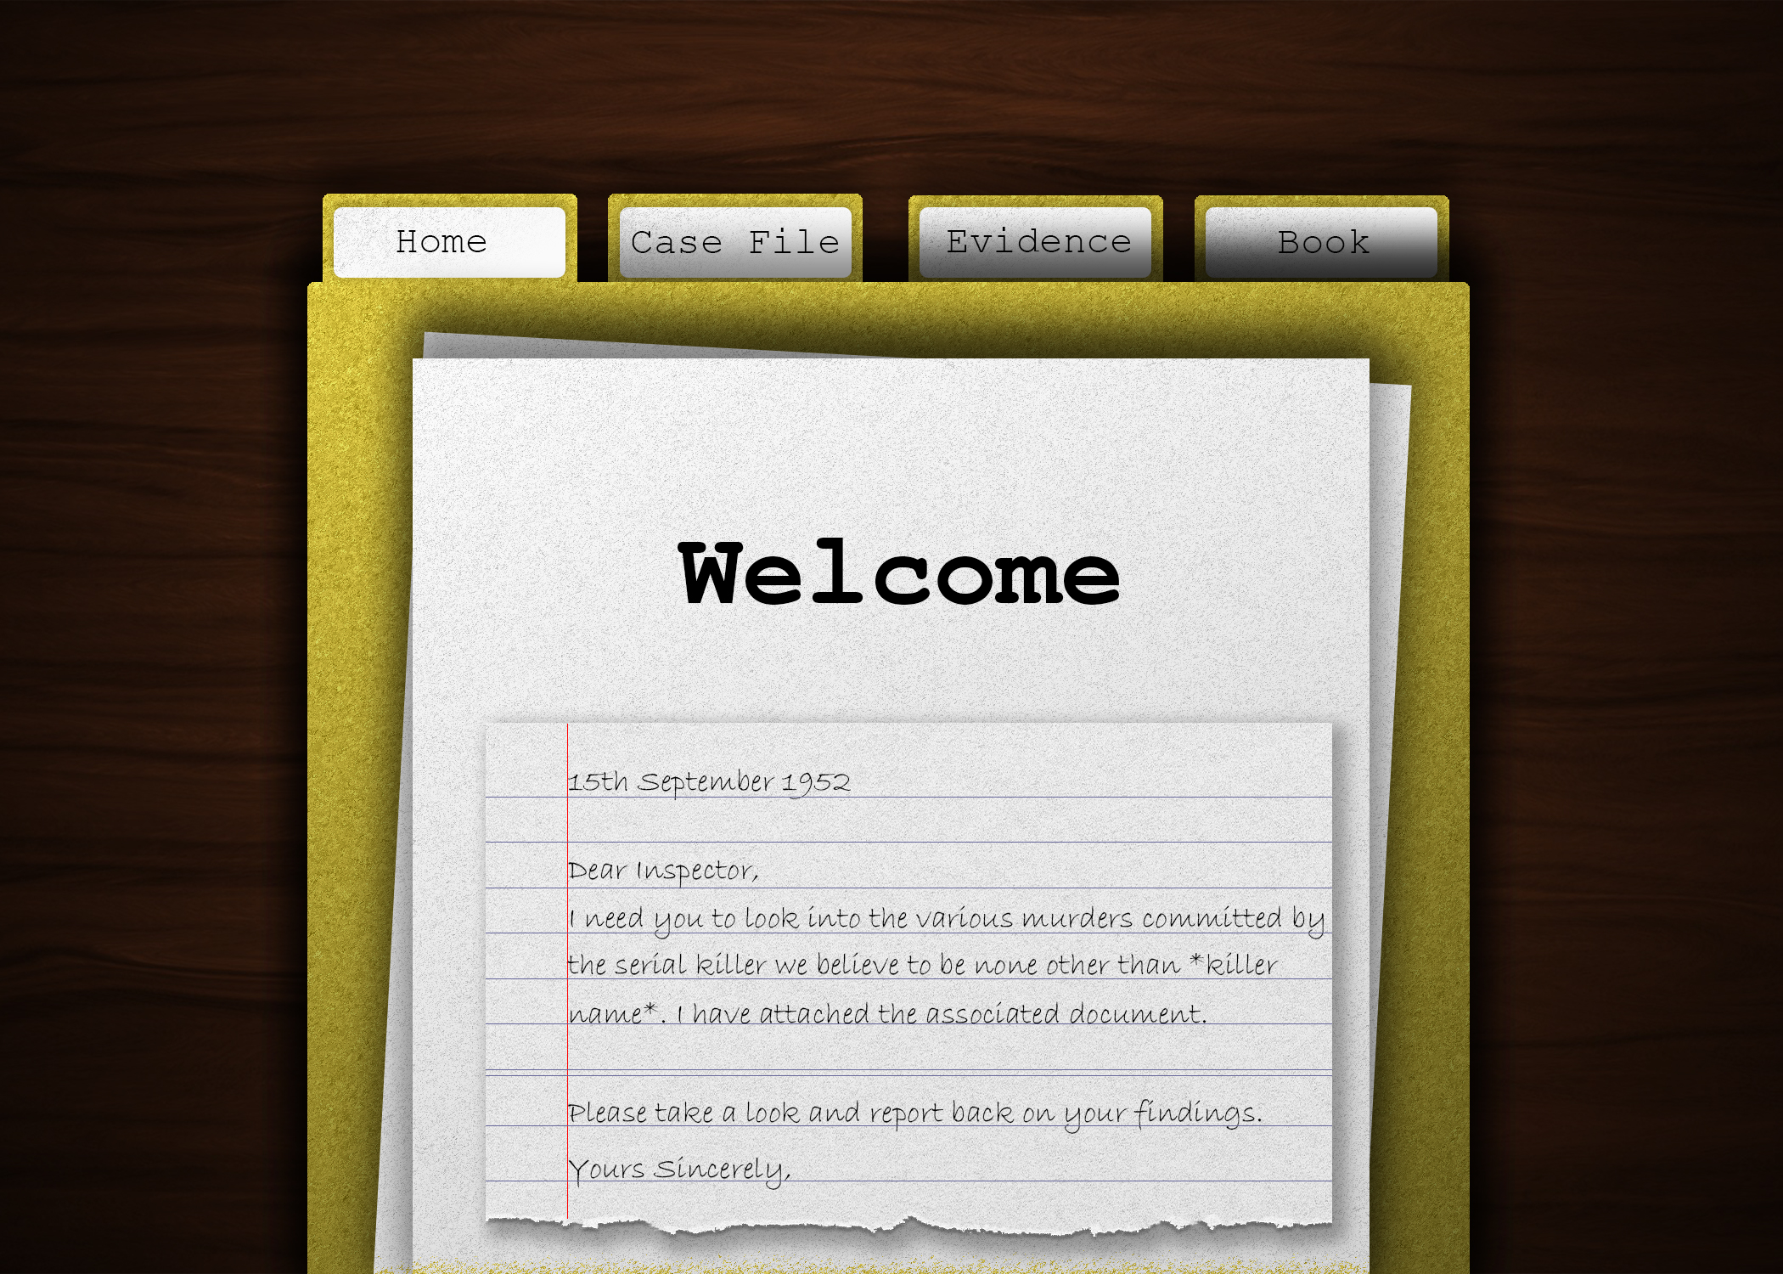
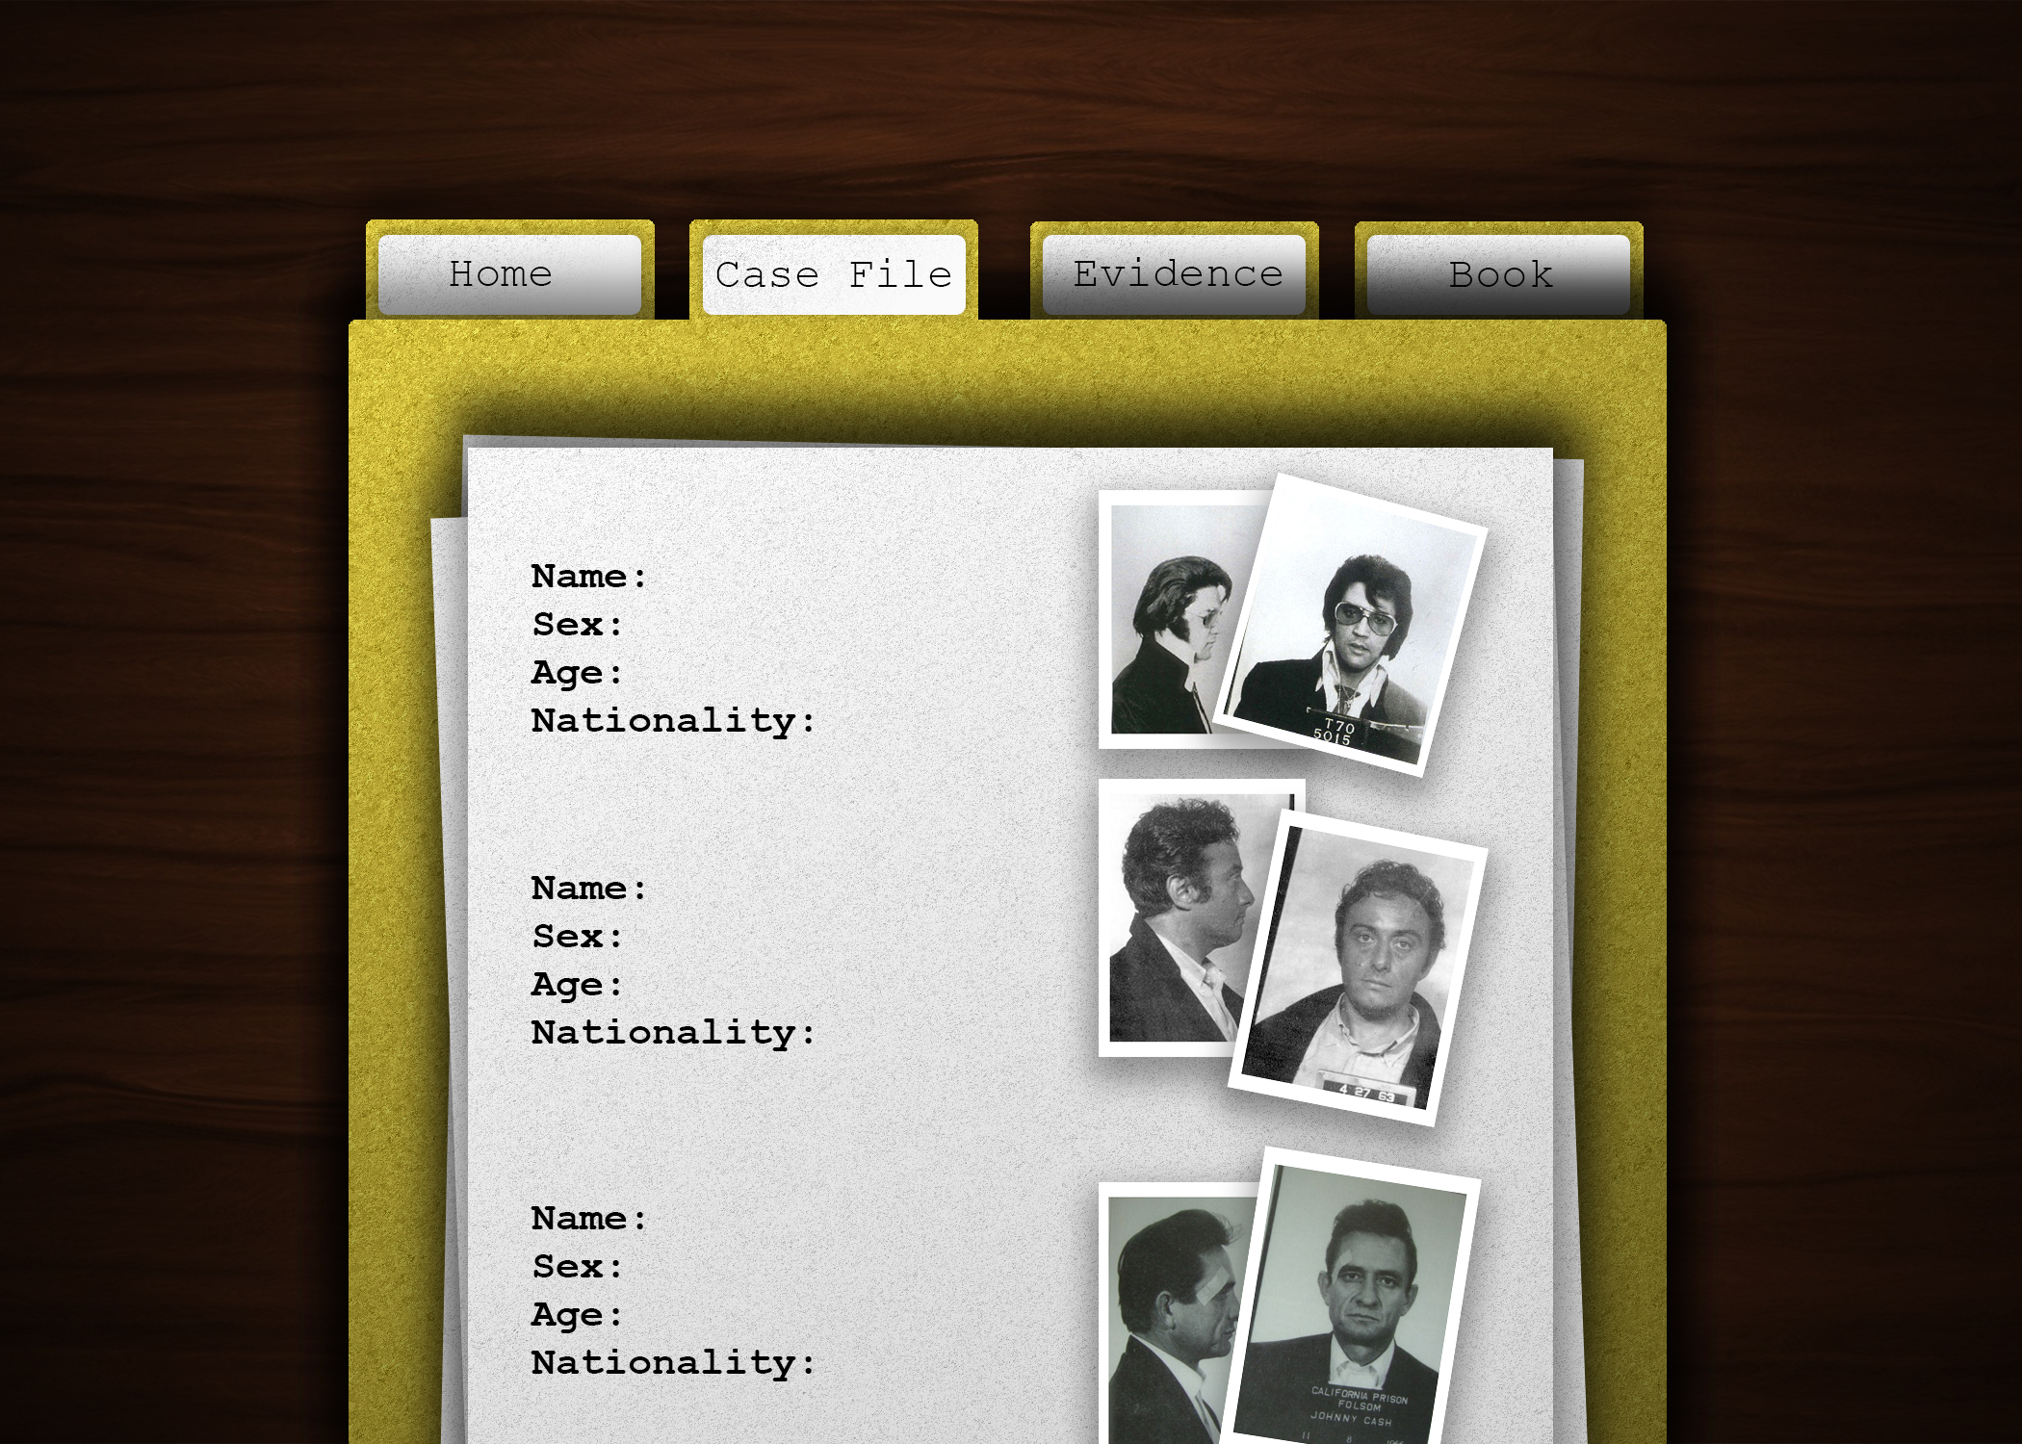
Home page
(High-fidelity Prototype)

Slide 7
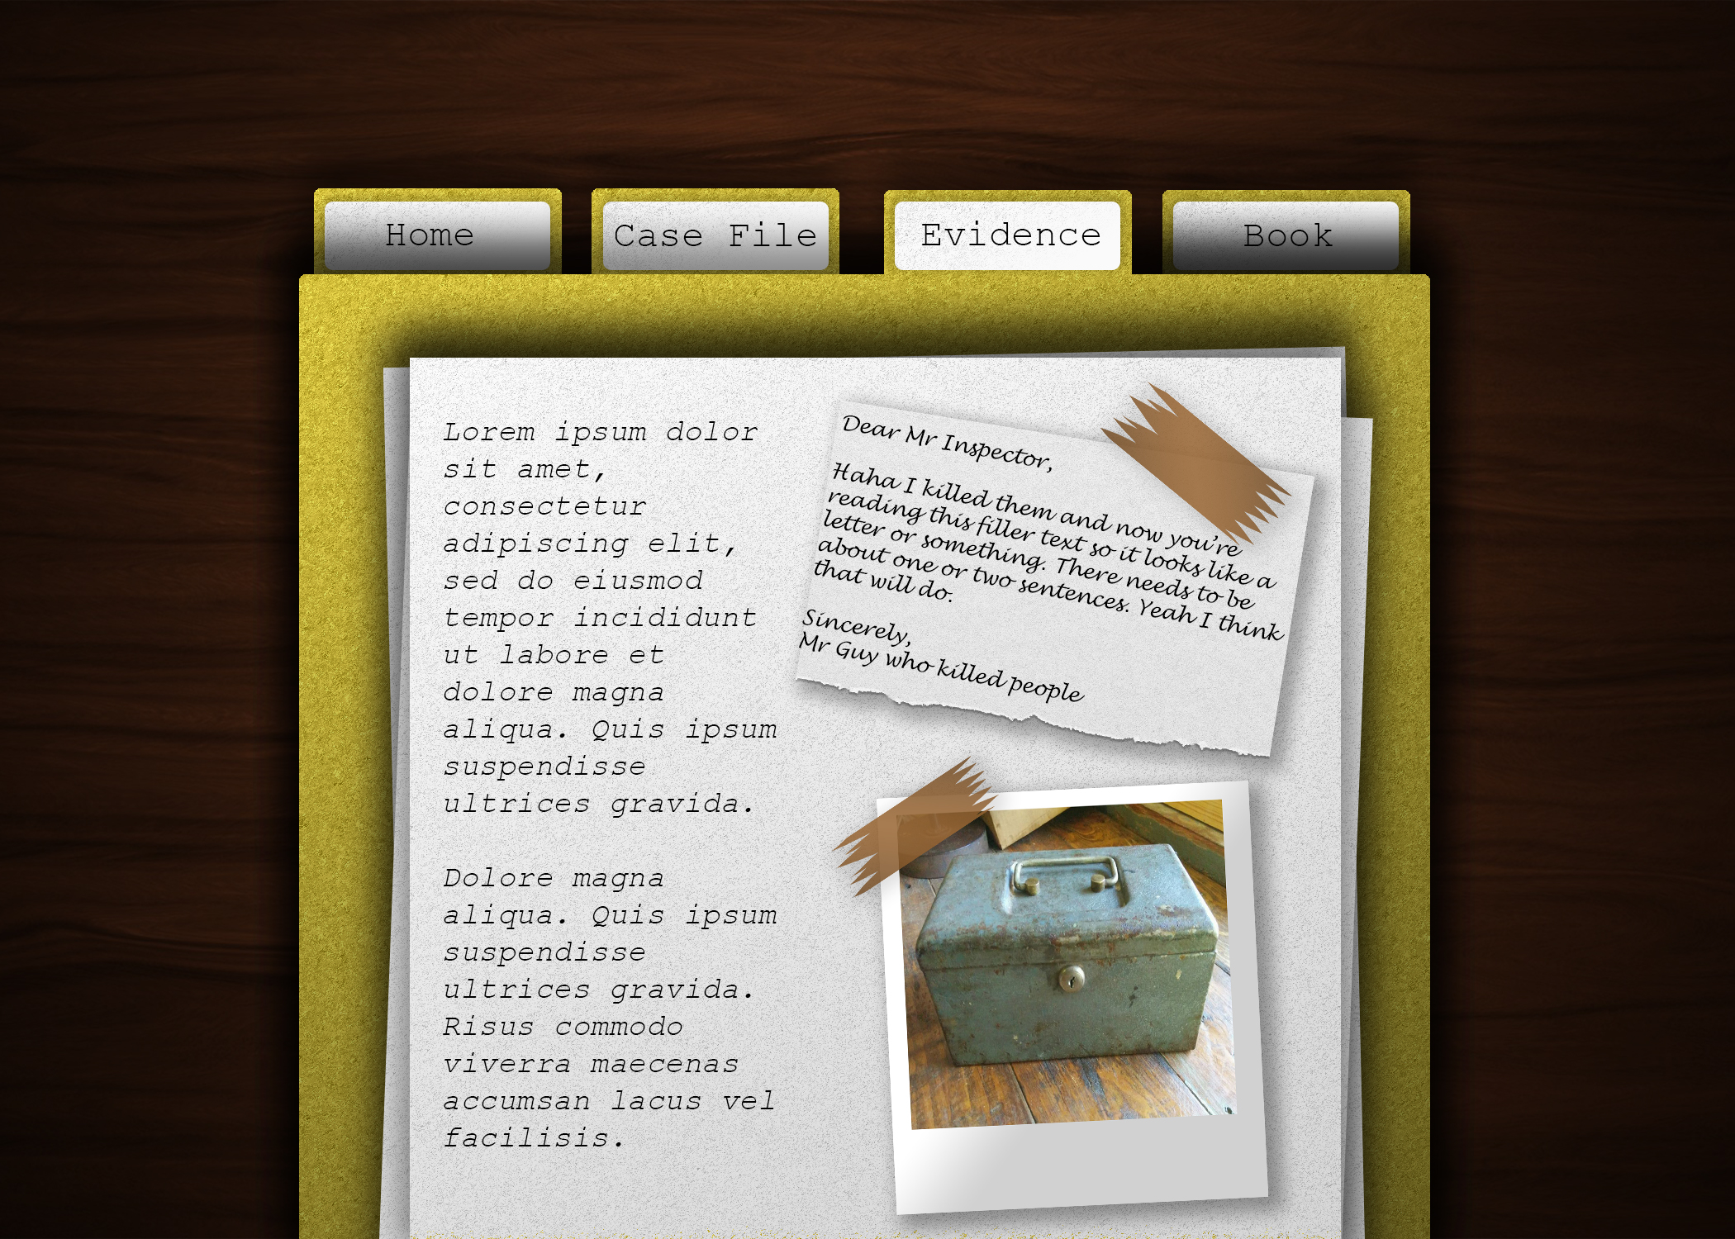
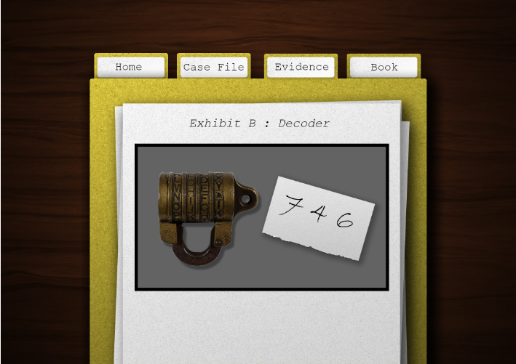
Before: Evidence page
(High fidelity)
Minigame

Slide 8
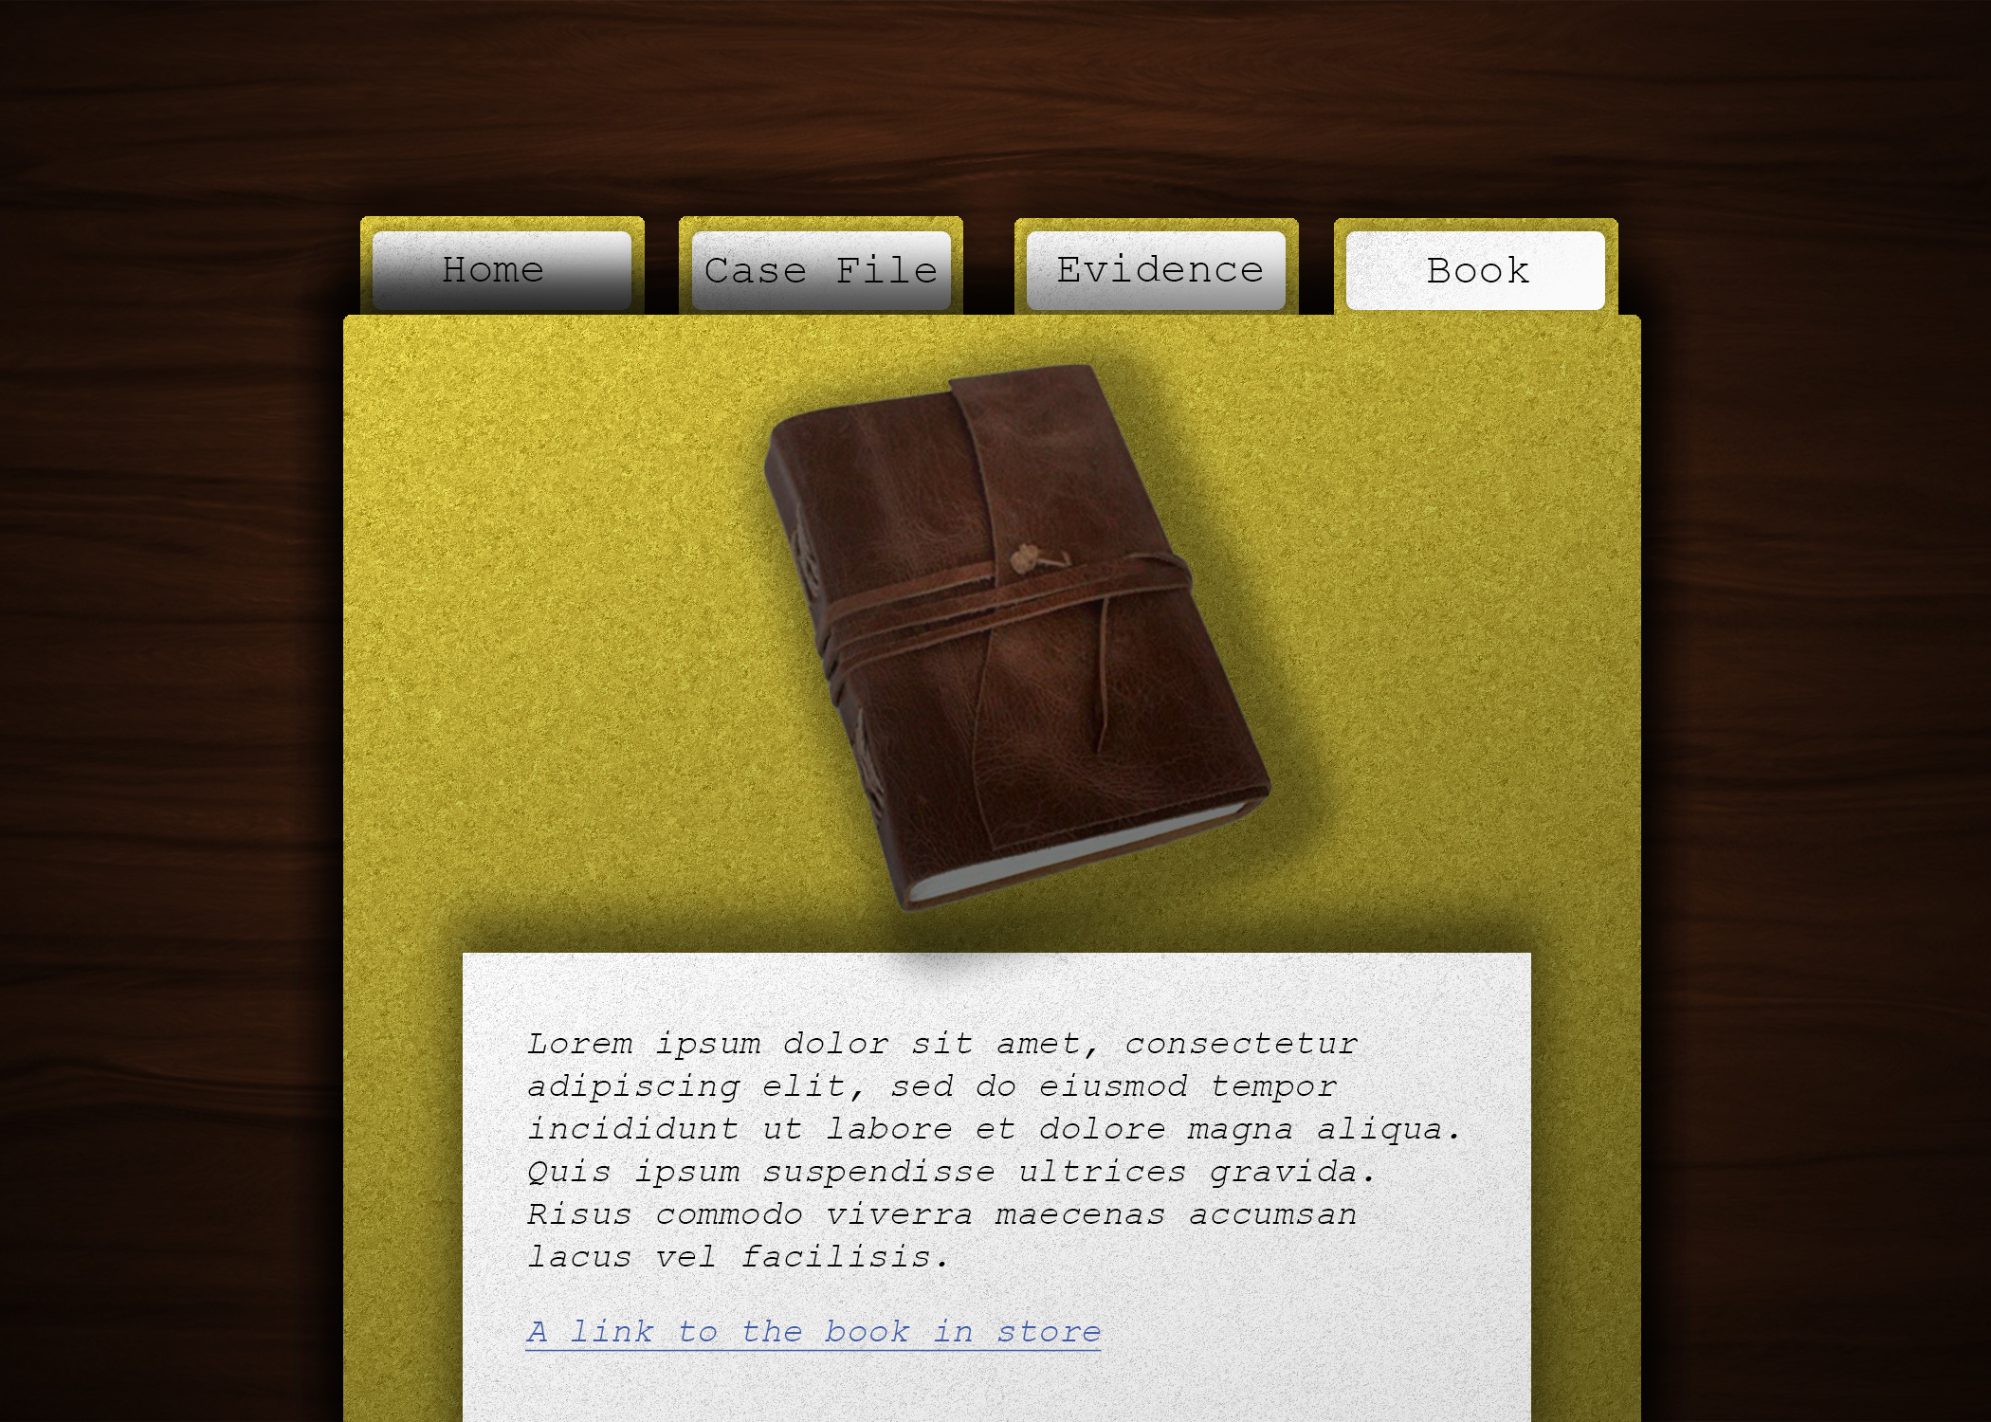
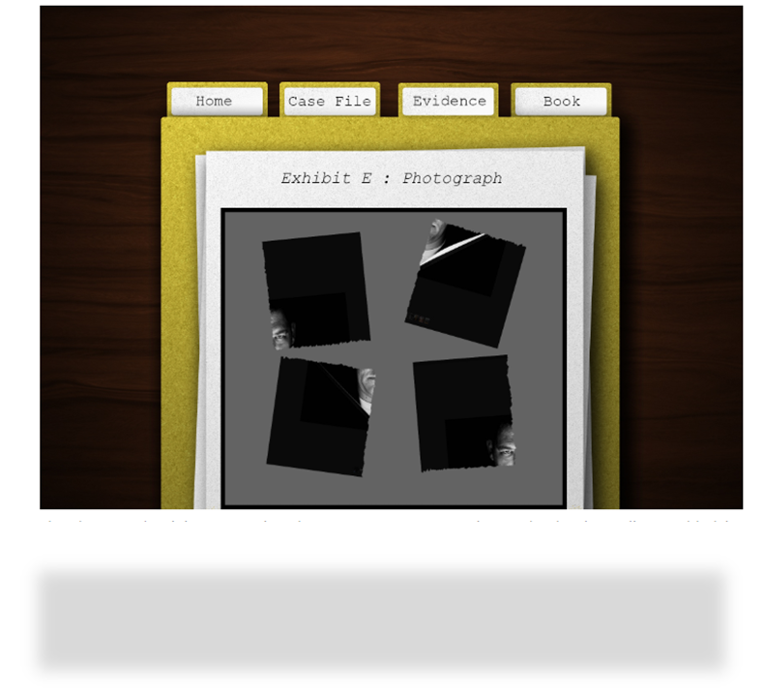
(High fidelity)
Book front cover
Photograph reconstruction

Slide 9
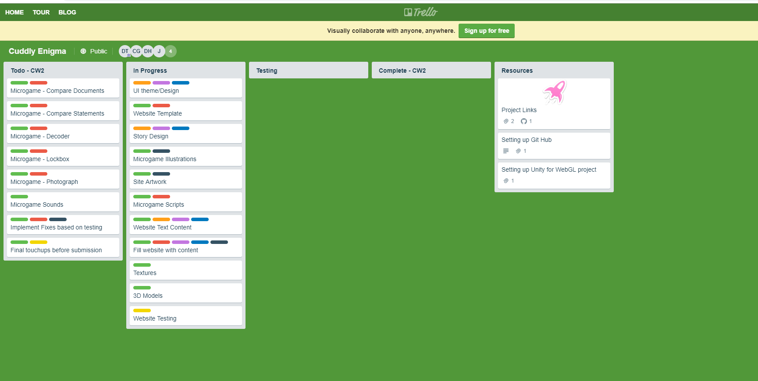
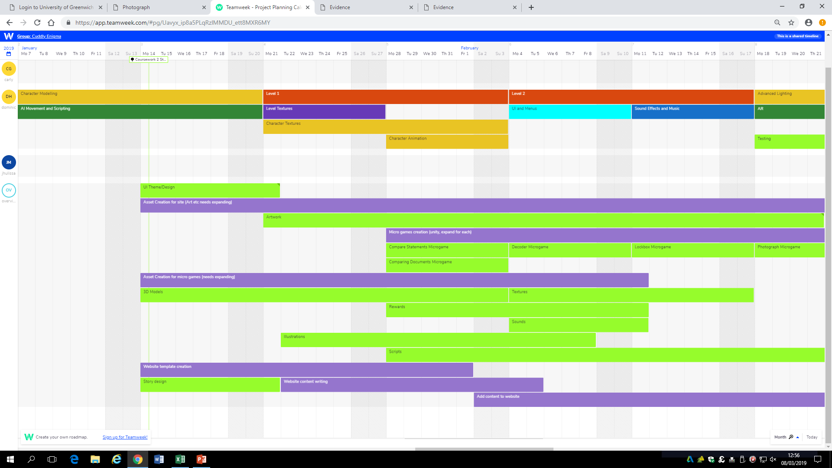
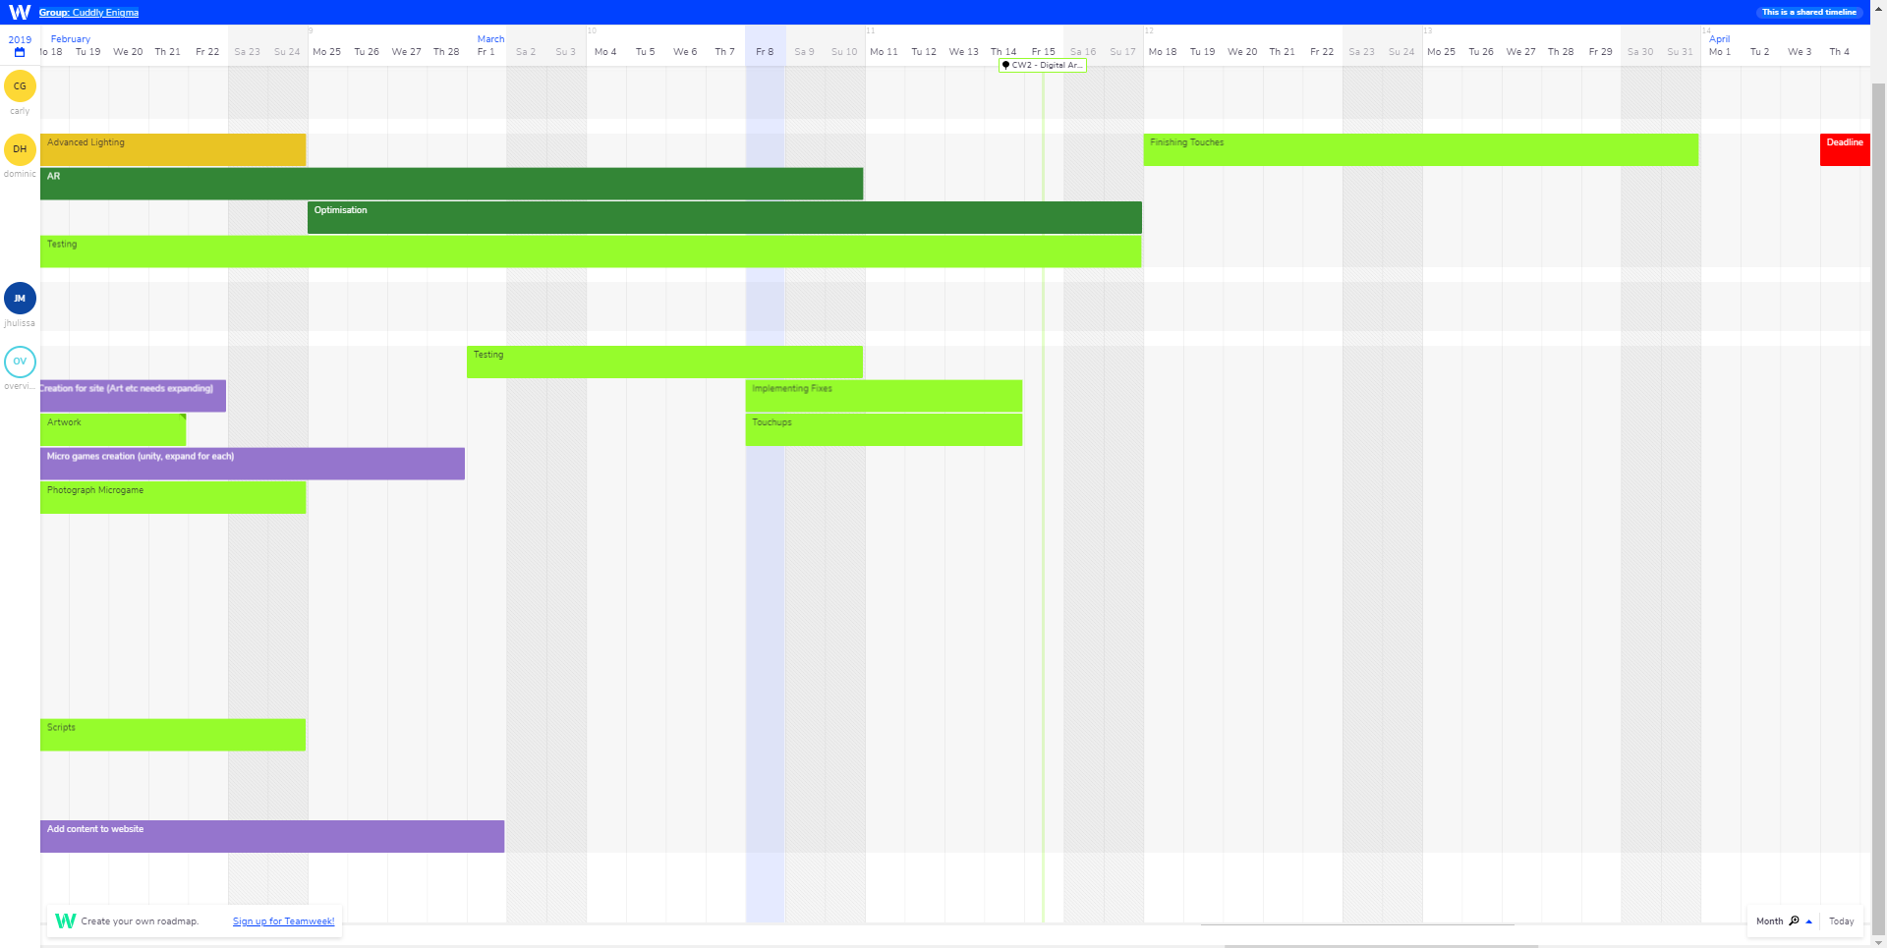
How we kept the process of our project

Slide 10
Feedback:

Slide 11
Thank you!

